Slide 1
Chapter 11
Organizational Learning and
Organizational Memory

Slide 2
Objectives
How Do Organizations Learn and Remember?
The Management of Organizational Memory
Organizational Learning
Organizational Learning and Organizational Memory Models

Slide 3
Introduction
Organizational knowledge is being lost at an alarming rate as businesses continue to downsize, to outsource, and to draw from a pool of increasingly mobile knowledge workers. Tacit knowledge has often been referred to as “the knowledge that leaves at the end of the day” and companies are said to “lease” knowledge but not own it. In an era of knowledge workers, individuals are increasingly responsible for value creation.

Slide 4
Introduction
Although many organizations have succession plans in place, the process usually involves transferring know-how from the departing employee to their successor, but the whole process has to be repeated again for the next departure. Organizations need to “capture” this know-how and transfer it to a stable, easily accessible, cumulative knowledge base — an organizational memory — to retain and make accessible valuable knowledge gained through the experiences of all knowledge in a continuous and uninterrupted manner.

Slide 5
How Do Organizations Learn and Remember?
Organizational learning (OL) can be defined as learning what worked and what did not work from the past and effectively transferring this experientially learned knowledge to present-day and future knowledge workers.
The organizational memory (OM) is a centralized technological system (often an intranet) where we can find all the by-products of OL: primarily the best practices and the lessons learned.
A learning organization (LO) is a type of organization that has successfully implemented the processes of organizational learning.

Slide 6
How Do Organizations Learn and Remember?
Senge (1990) lists five key attributes that a learning organization should have. His book, The Fifth Discipline, was one of the first to identify the core competencies a learning organization should have as:
    1. Mental models
    2. Shared vision
    3. Personal mastery
    4. Team learning
    5. Systems thinking

Slide 7
How Do Organizations Learn and Remember?
Mental models: are the coherent set of understandings or models that allow individuals to make sense of their world and to make decisions accordingly. A mental model can consist of experiential learning, things learned “the hard way,” perceptions, values, beliefs
The process of sharing can and often does lead to a modification of existing models so that the individuals involved can come closer together with respect to a shared mental model of their organization.
Personal mastery: refers to a set of values and attitudes such that individuals are committed to lifelong learning—which in turn enables the organization to engage in lifelong learning.

Slide 8
How Do Organizations Learn and Remember?
Team learning is the organizational values and attitudes that actively foster individual learning such as investment in training. An organization that supports individual learning is much more likely to be capable of organizational learning.
Systems thinking refers to the perception or definition of an organization as a gestalt, an integral entity that cannot be reduced to a series of components. Systems thinking is also an excellent way of viewing KM: as an intact system made up of processes, people, culture, technology, and so forth.

Slide 9
How Do Organizations Learn and Remember?
For organizational learning to occur, the individual would have to embed the knowledge in a repository such as a database, routine, or transactive memory system.
By embedding the knowledge in a supra-individual routine, the knowledge would persist even if the member who acquired the knowledge left the organization and other members could access the knowledge.

Slide 10
The Management of Organizational Memory
There are good reasons to pursue the creation of organizational memory.
Organizations routinely forget what they have done in the past and why they have done it. These organizations have an impaired capacity to learn, due to an inability to represent critical aspects of what they know.

Slide 11
The Management of Organizational Memory
Organizational memory is not just a facility for accumulating and preserving but also for sharing knowledge.
As knowledge is made explicit and managed, it augments the organizational intellect, becoming a basis for communication and learning.
Organizational memory contributes to the overall governance and compliance with regulatory guidelines.
An organizational memory can also help increase the transparency of the organization as well as how knowledge workers perceive this transparency.

Slide 12
The Management of Organizational Memory
Once valuable knowledge content has been entered into organizational memory, it can be shared among individuals working alone, by teams needing a project memory, and by the organization as a whole for “between-team” coordination and communication.
Given the nature of organizations and the competitive environment within which they exist, organizational learning and the accumulation of knowledge will be source of immediate health as well as long-term survival

Slide 13
The Management of Organizational Memory
The obstacles to an effective organizational memory system: cultural and technical.
The cultural barriers include the following:
A cultural emphasis on artifacts and results to the exclusion of process
Resistance to knowledge capture because of the effort required, the fear of litigation, and the fear of loss of job security
Resistance to knowledge reuse because of the effort required, and the low likelihood of finding relevant knowledge

Slide 14
The Management of Organizational Memory
The obstacles to an effective organizational memory system: cultural and technical.
The technical barriers include:
How to make the knowledge capture process easy or even transparent
How to make retrieval and reuse easy or even transparent
How to ensure relevance and intelligibility (i.e., through sufficient context) of retrieved knowledge

Slide 15
Organizational Learning
An organizational lesson learned or best practice is one that has broader applicability—it is not limited to a particular context or particular event and offers reuse potential to an organization-wide audience.

Slide 16
Organizational Learning
These diverse definitions highlight some key attributes of lessons learned:
  They can be learned from both successful and unsuccessful events.
  They can be at the operational, tactical, and/or strategic levels.
  They need to be validated in some way.
  They need to be applied by people other than those involved in the original event.
  They must be significant enough to pass a cost–benefit analysis.

Slide 17
Organizational Learning
In general two types of learning occur in organizations (O’Dell and Grayson, 2001):
  1. Top-down learning is a strategic learning method whereby management, at any given level, decides that a certain piece of knowledge is vital to the organization and must be learned by its employees.
  2. Bottom-up learning happens in the actual “doing” of tasks; it is experiential learning and results from both positive and negative events.

Slide 18
Organizational Learning
The Lessons Learned Process
  Effective knowledge management processes involves the identification, creation, acquisition, dissemination, and reuse of knowledge assets to provide a strategic advantage.
  The lessons learned process has a similar cycle of activities, although there is less agreement on what these specific stages should be.

Slide 19
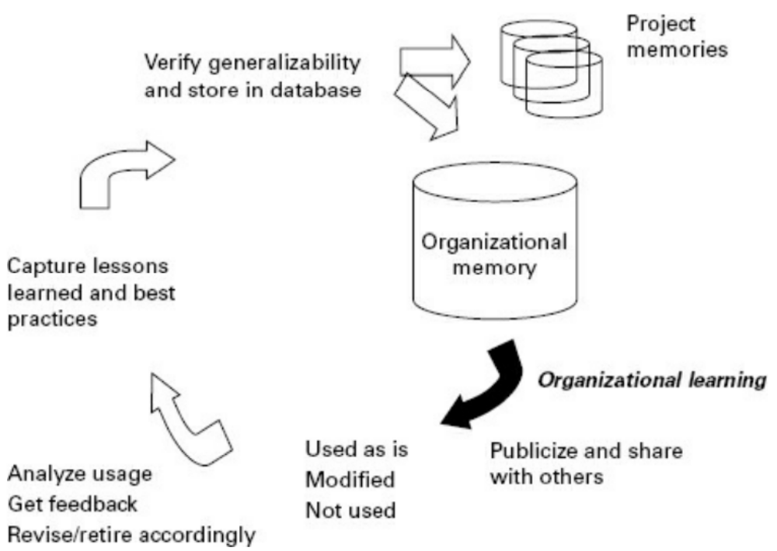
Organizational Learning

Slide 20
Organizational Learning
  The Lessons Learned Process
  1. Collection: Capture of lessons through structured or unstructured processes, such as after-action or project reviews, meetings, training evaluations, etc. Capture may be done at all levels: individual, community, and organization.
  2. Verification: Lessons are verified before dissemination to ensure that they are valid and applicable. This process may involve subject-matter experts or additional research, and the lessons are typically verified to ensure that they meet or exceed a set of defined criteria outlined in established standards.

Slide 21
Organizational Learning
  The Lessons Learned Process
  3. Storage: Once approved, lessons are stored in an accessible database in a format that allows for easy search and retrieval of information. Some storage issues include categorization, indexing, formatting, and structure.
  4. Dissemination: Active dissemination of lessons is essential for getting value out of a lessons learned program; lessons are of little benefit unless they are accessed and reused. Dissemination can be active (lessons are pushed to potential users) or passive (users access a repository to retrieve lessons).

Slide 22
Organizational Learning
Methods for Managing Lessons Learned
  Kitimbo (2015) outlines a number of approaches that can be used to complete the steps in the LL processing lifecycle. Major types include after action reviews, project post mortems, and reporting systems.

Slide 23
Organizational Learning
Methods for Managing Lessons Learned
  The basic questions to be answered in all approaches:
    What was planned? What actually occurred?
    In cases where the two differed, did we do better or worse than expected? What are some possible reasons why?
    What would we do differently based on this experience? What should we keep doing?
    What should we avoid repeating in the future?

Slide 24
Organizational Learning
Lessons Learned Systems
  Schindler and Eppler (2003) note that experiential learning is necessarily a personal experience by the individual who was involved in the event or project.
  People solve problems during the course of their work.

Slide 25
Organizational Learning
Benefits of Lessons Learned
  There is a benefit in making the time (and space) for reflective thinking. Most organizations are too busy doing to think about what they are doing.
  Reflective observation is an excellent practice to be able to evaluate the efficiency and effectiveness of all organizational activities, whether they be mundane or routine operational tasks or a five-year strategic planning exercise.

Slide 26
Organizational Learning
Benefits of Lessons Learned
  1. Project managers learn how to manage experientially as they learn to reflect on their projects and consult other projects’ lessons learned that are relevant.
  2. Lessons learned can contribute to the feasibility and risk assessment of other projects and help managers plan them better.
  3. The project management process is improved.
  4. Management decision making is improved.
  5. Lessons learned can be used for benchmarking.
  6. Lessons learned can lead to innovations such as new products and services.
  7. The organization’s strategic focus may be adjusted.

Slide 27
Organizational Learning
Some Challenges
  One of the first barriers to be encountered is at the lesson learned elicitation stage.
  Asking people to publicly admit that everything did not go perfectly according to plan.
  Participants are very defensive, lacking in trust, and expecting to be judged in some manner.

Slide 28
Organizational Learning
Some Challenges
  A good idea to start with the positive—what went well, what went better than expected.
  When addressing what went wrong, the tone must again be positive even though we are discussing something negative.
  The goal is to improve, to avoid costly mistakes, and to change how things are done.

Slide 29
Organizational Learning
Some Challenges
  Zedtwitz (2002) identified four main categories of obstacles to successfully implementing lessons learned:
      1. Psychological barriers
      2. Team-based shortcomings
      3. Epistemological constraints
      4. Managerial problems

Slide 30
Organizational Learning
Benefits of Lessons Learned
  Psychological barriers refer to reluctance to look back into what happened in the past. Employees may not be motivated to talk about a project failure, especially if they were at all involved in the reason it failed.
  Team-based shortcomings refer to how well the team worked together. Team members may not have necessarily gotten along well, they may have had incompatible working styles, communication may have been poor or roles not clearly defined.

Slide 31
Organizational Learning
Benefits of Lessons Learned
  Epistemological constraints refer to cognitive challenges such as difficulty in trying to abstract or generalize from a specific incident to a broader scope lesson to be learned.
  Managerial problems have already been mentioned and they are mostly related to lack of time to reflect, lack of lessons learned guidelines, failure to comply with guidelines, and lack of managerial support.

Slide 32
Organizational Learning and Organizational Memory Models
Huysman and de Wit (2002) identify three fundamental stages in knowledge processing:
  (1) Internalization, where knowledge is learned and understood by the knowledge sharers;
  (2) Externalization, where knowledge is exchanged or reused and new knowledge can be derived from the shared knowledge;
  (3) Objectification, where shared knowledge is accepted and institutionalized as organizational knowledge.

Slide 33
Organizational Learning and Organizational Memory Models
Assessment Frameworks
  The organizational learning frameworks serve to evaluate the organizational readiness or baseline state of a given organization with respect to organizational learning processes, organizational memory containers, and enablers of these, such as technology and culture.

Slide 34
Organizational Learning and Organizational Memory Models
Assessment Frameworks
  One framework, proposed by Probst and Buchel (1997) looks at the following organizational factors:
      1. Knowledge—the number of organizational learning instruments
        a. Number of techniques for facilitating learning
        b. Number of techniques for breaking down barriers
        c. Process-oriented use of techniques

Slide 35
Organizational Learning and Organizational Memory Models
Assessment Frameworks
  One framework, proposed by Probst and Buchel (1997) looks at the following organizational factors:
      2. Ability—the learning level
        a. Ability to cooperate and participate
        b. Ability to communicate and achieve transparency
        c. Ability to analyze problems and solve complex issues
        d. Ability to store knowledge

Slide 36
Organizational Learning and Organizational Memory Models
Assessment Frameworks
  One framework, proposed by Probst and Buchel (1997) looks at the following organizational factors:
      3. Intention - the willingness to learn
        a. Creates a structure which imparts meaning
        b. Builds on an ethical basis
        c. Wants to create a shared value system

Slide 37
Summary
Organizational learning is the process of applying knowledge from the past to present-day work challenges.
Managing organizational memory often means overcoming barriers to the processing of experiential knowledge accrued by knowledge workers over time.
A lesson learned is defined as organizational learning from work experiences of its members.
The major challenges are motivating people to participate, getting management to support, and transforming tacit experiential knowledge into an explicit form that can be easily found and reused.

Slide 38
Discussion / Homework / Team Activities
How would you assess the success of your OM systems—e.g., a lessons learned, best practice, or story database? What sorts of tools would you use? Who would be involved? How would you act on the feedback you collected? What are some ways in which you could boost the adoption rate of the content?
Compare and contrast some of the leading theories on organizational learning and organizational memory. Why are there so many with so little intersection—what do you think may have caused this fragmentation? How would you go about trying to put the various pieces together in order to better understand the processes of OL?
How would you integrate OL objectives within a KM metrics framework? What sorts of organizational goals would be addressed and what would the KM contributions be?

Slide 39

Discussion

